Slide 1
DAVI CA2 Seaborn Objective: To identify how gpa is distributed and how it relates to other variables Name: Isaac Low ID: p2342348

Slide 2
agenda
Nature of the dataset
Data cleansing and wrangling
Charts
Insights
Conclusion and recommendation

Slide 3
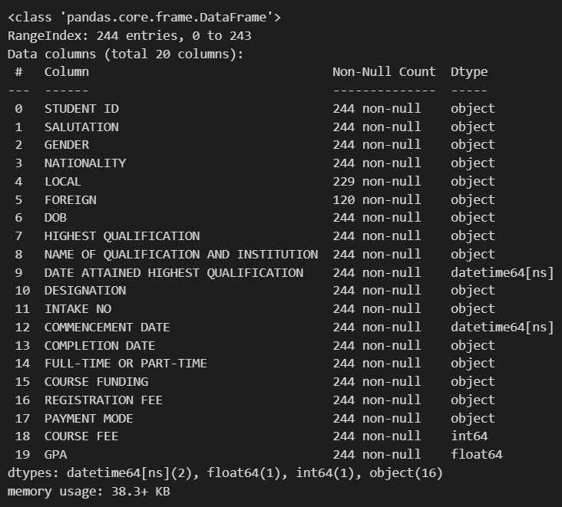
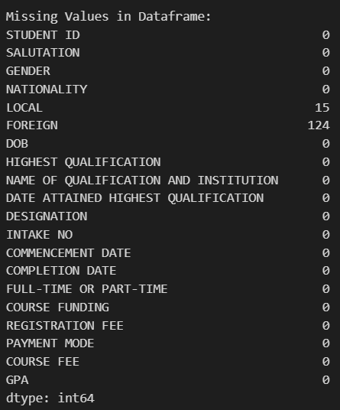
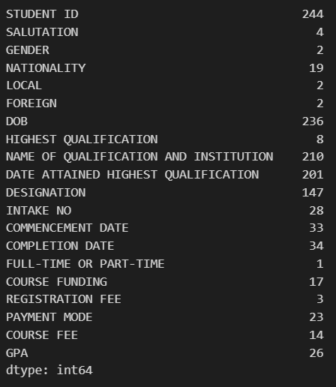
Nature of the dataset
Data Types: Mostly categorical data (16 object columns)
2 datetime columns (DATE ATTAINED HIGHEST QUALIFICATION, COMMENCEMENT DATE)
1 integer column (COURSE FEE)
1 float column (GPA)
Here we can see that the dataset contains 20 columns with foreign and local having some na values. We also can see the different columns having different numbers of unique values
Potential Analysis Areas: Student demographics and diversity
Academic performance trends
Course popularity and enrollment patterns
Financial aspects of courses
Relationship between qualifications and academic performance

Slide 4
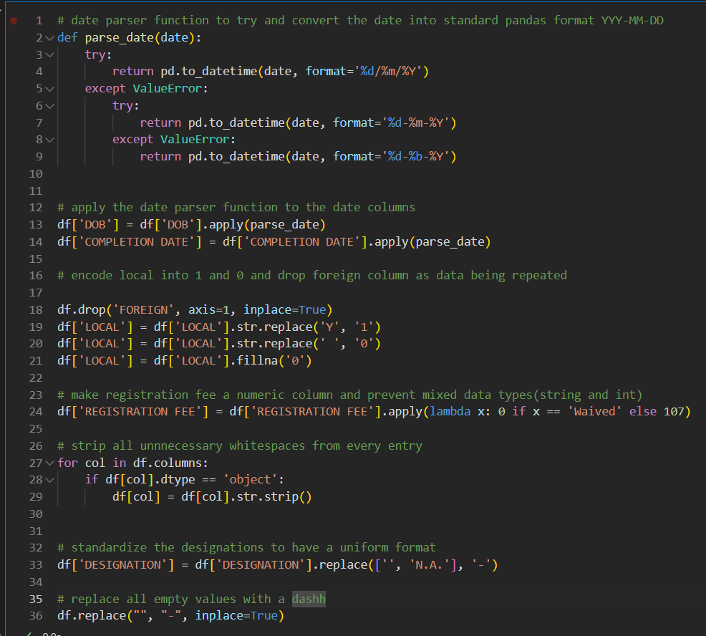
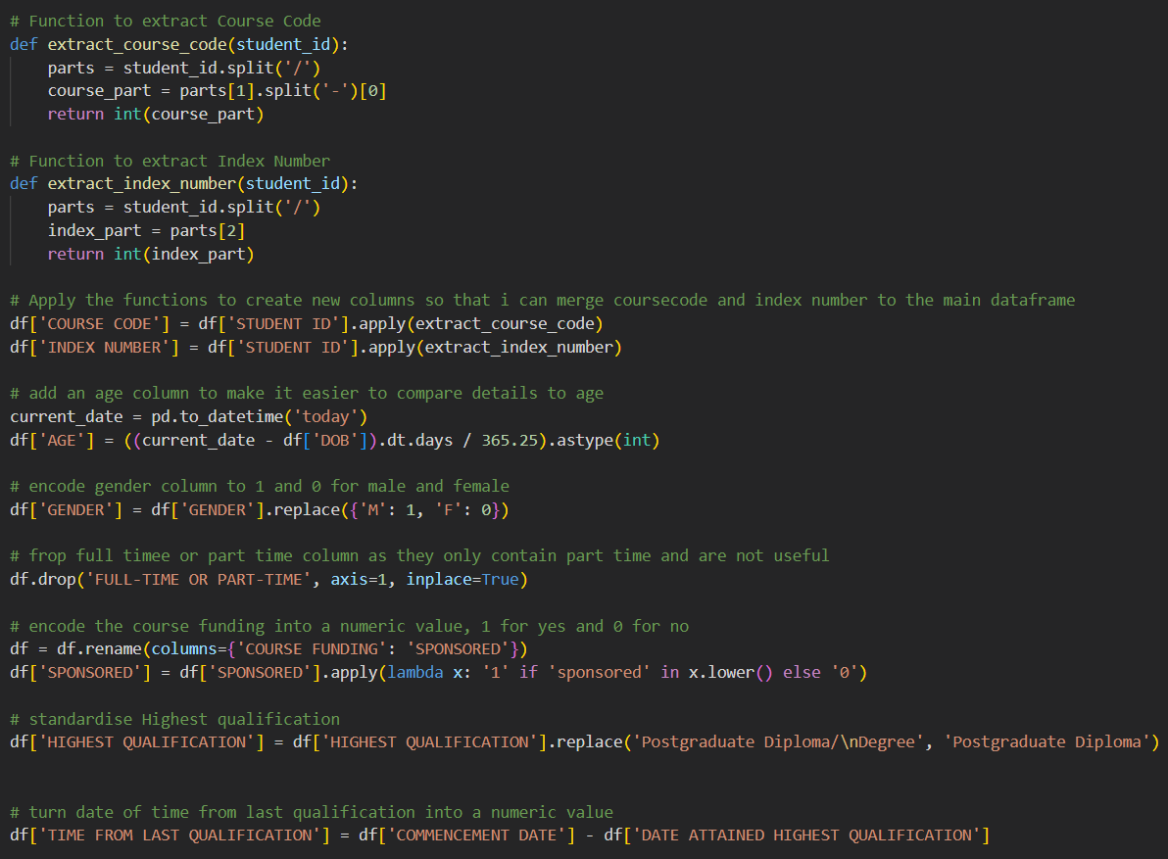
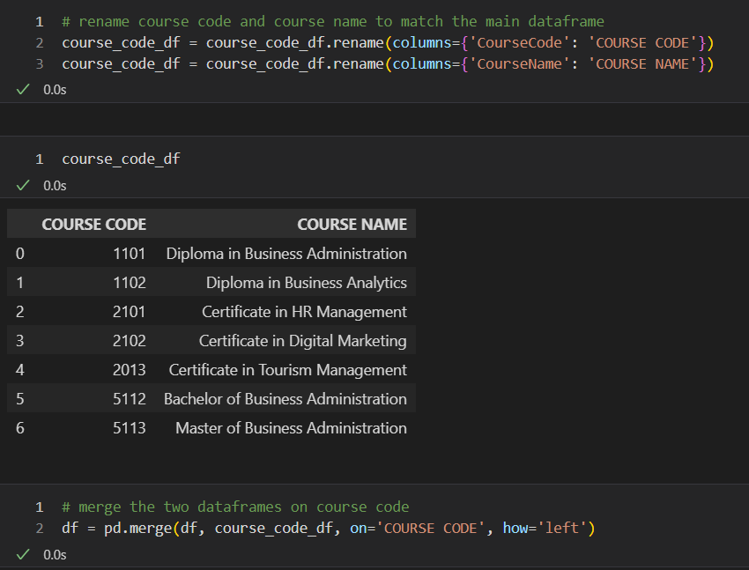
Data cleansing and wrangling
The data cleansing and wrangling process involved several key steps: datetime conversions for date-related columns, encoding categorical variables, numeric conversions for fees and age calculation, data cleaning through standardization and whitespace removal, feature engineering to extract course codes and index numbers, column management to remove redundant information, handling missing data, and merging with a course code data frame.
These operations transformed the raw dataset into a structured, consistent format suitable for comprehensive analysis, addressing issues of data inconsistency, missing values, and improving overall data quality and usability.

Slide 5
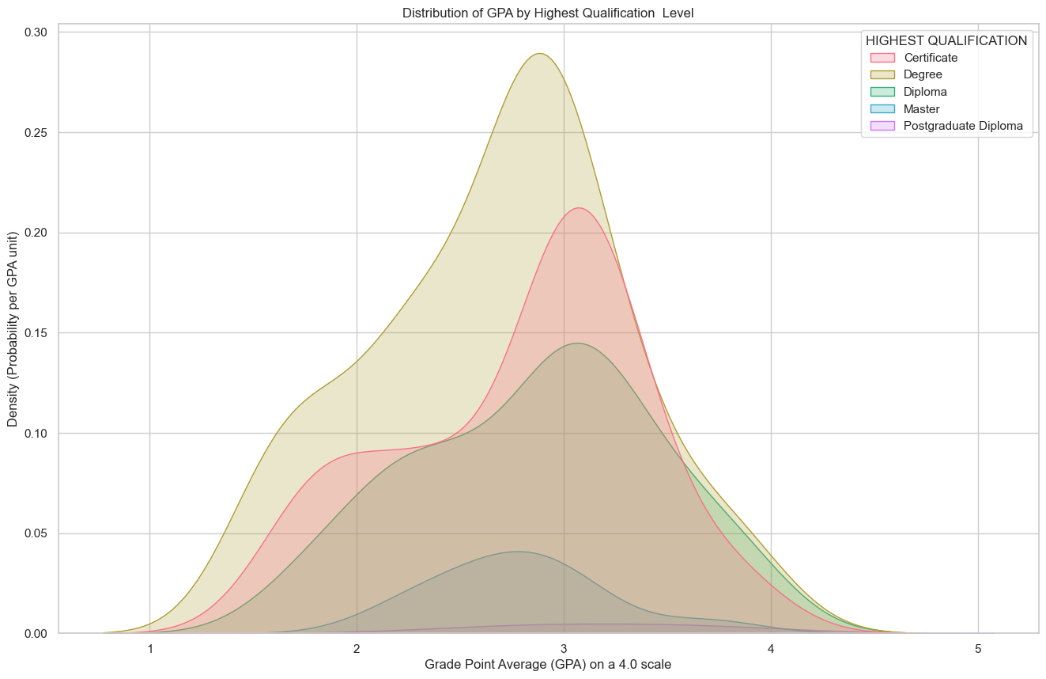
Chart 1: Univariate Analysis
Kernel density estimation plot of GPA by highest qualification.
Insights:
the plot shows that People with diplomas tend to score the best at this institute, scoring around 3.1, followed by people with just a certificate at around 3.0, then by people with degrees and Masters. post graduate diplomas do not contain enough examples to show an accurate depiction. this is quite counterintuitive as people with higher qualifications are scoring lower in this program
the distribution for all the graphs are unimodal, with most of the graphs being negatively skewed except Masters degrees that are positively skewed this means that: Most students have higher GPAs, with the bulk of the data concentrated on the right side of the distribution. There is a longer tail extending to the left, representing fewer students with lower GPAs. And the inverse is true for students with Masters degrees

Slide 6
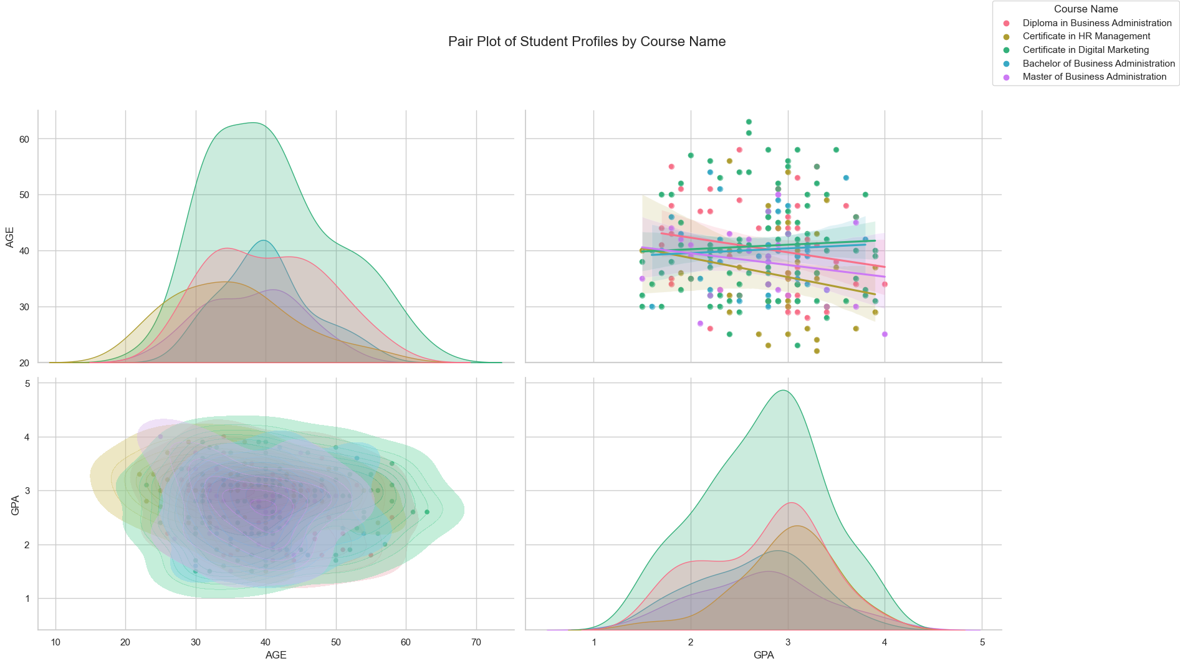
Chart 2: bivariate Analysis
Pair plot consisting of a KDE plot of Age and GPA by Course, and scatter plots of age against GPA
Insights:
GPA distributions across all courses are unimodal with negative skew, indicating most students achieve higher GPAs while a smaller group pulls the average down. Mode GPAs range from 2.8 to 3.0, with Certificate in HR Management and Diploma in Business Administration at the top. This consistent pattern suggests a need to investigate factors affecting lower-performing students and potentially review grading practices or support systems.
Age distributions reveal intriguing patterns. Master and Diploma of Business Administration programs show bimodal age distributions, suggesting they attract both early-career professionals and more experienced individuals. Other courses have unimodal age distributions, with Bachelor of Business Administration having the highest mode age at 40, while certificate courses attract younger professionals with mode ages around 30-31.
The relationship between GPA and age shows weak correlations across all courses, with r-scores ranging from -0.20 to 0.07. This indicates that age is not a strong predictor of academic performance. The slight variations in correlation direction and strength might reflect subtle differences in how age relates to GPA in different programs, but overall, other factors are likely more influential in determining academic success.

Slide 7
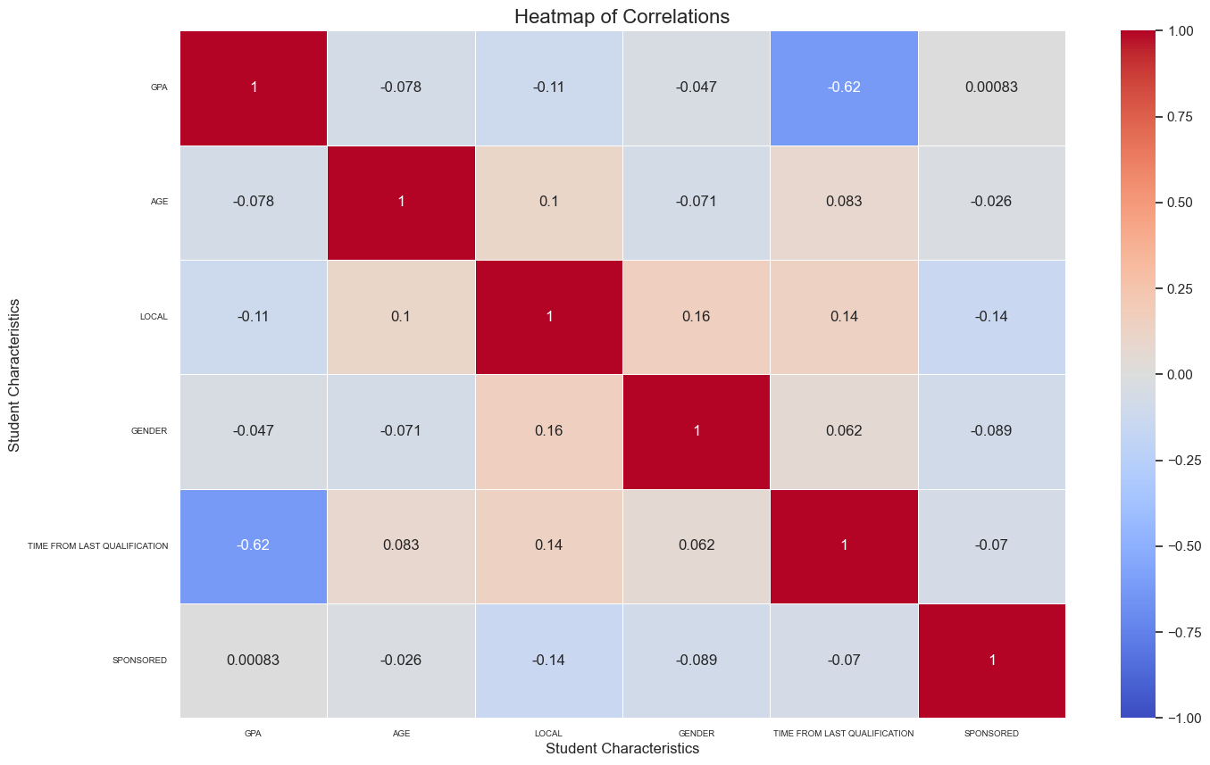
Chart 3: Multivariate Analysis
Heatmap of GPA, Age, Local, Gender, Time from last qualification, and Sponsored.
Insights:
here we can see that time from last qualification has the largest correlation at (-0.62) which is a strong correlation GPA has weak negative correlations with local status (-0.11) and age (-0.078), but these are not strong enough to draw firm conclusions. And there is practically no correlation between GPA and sponsored status (0.00083), which is interesting given that sponsorship doesn't seem to impact academic performance
Local status has weak correlations with gender (0.16), time from last qualification (0.14), and sponsored status (-0.14).
Sponsored status shows very weak correlations across the board, with the strongest being a weak negative correlation with local status (-0.14).

Slide 8
Recommendations
Based on the strong negative correlation between GPA and time since last qualification, implement an "Academic Reintegration Program" for returning students. This should include refresher courses, tutoring, adult-focused study skills workshops, and regular advisor check-ins. This targeted support aims to help students readjust to academic life and improve their performance.
To address the counterintuitive finding of lower GPAs among those with higher qualifications, conduct a comprehensive review of advanced degree programs. Assess course content alignment, evaluate assessment methods, gather stakeholder feedback, and consider flexible learning structures. This approach seeks to tailor programs to diverse student needs and experiences, potentially enhancing academic outcomes

Slide 9
Conclusion
These findings provide a comprehensive view of academic performance factors, laying the groundwork for data-driven improvements in academic support and program design.

